Slide 1
Business Analytics
Elective
Prepared by
Dr. Rauf Ahmed Shams Malick

Slide 2
Course Coverage
Understanding Analytics
Understanding Business
Business Value
Business Processes
Key Performance Indicators
Data Pipeline
Framework for Data and Analytics
Integrated Data, Analytics and Knowledge

Slide 3
Business Types
B2C
B2B
Marketplace
Online Auctions
Referral sites

Slide 4
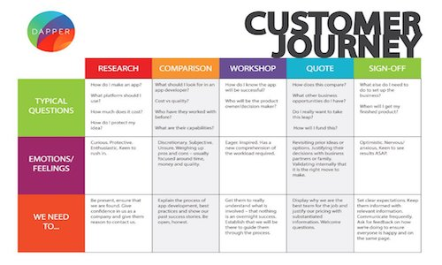
Product based Customer Experience / Usability
Mapping out the customer journey is an effective way to understand what turns a viewer into a long-term, loyal customer. – Kofi Senaya, Director of Product at Clearbridge Mobile

Slide 5
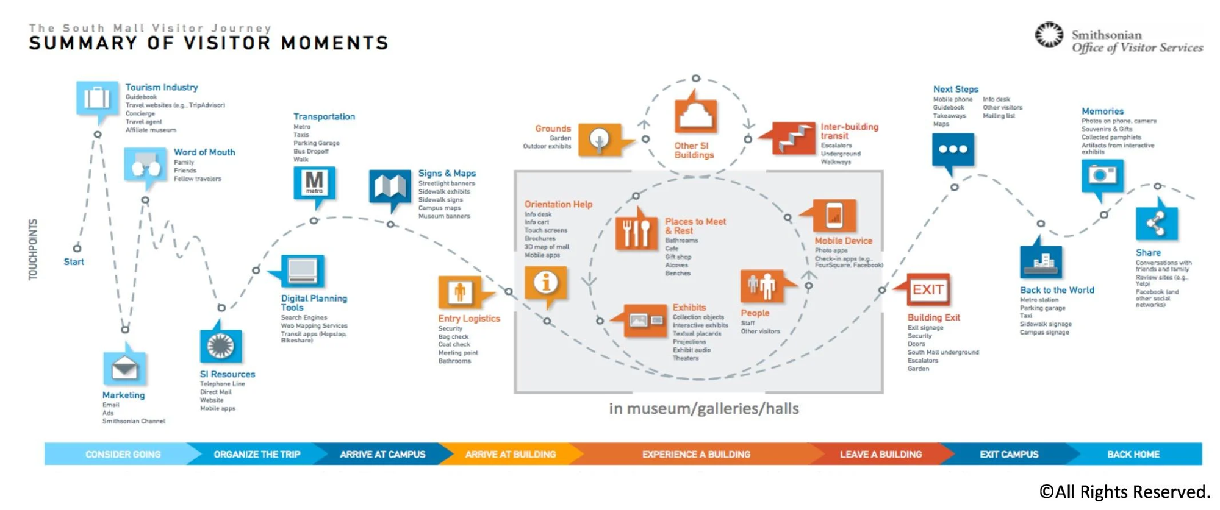

Slide 6
A Customer Journey map is a visual or graphic interpretation of the overall story from an individual’s perspective of their relationship with an organization, service, product or brand, over time and across channels. […] The story is told from the customer’s perspective, but also emphasizes the important intersections between user expectations and business requirements – Megan Grocki at UX Mastery

Slide 7
Customer Analytics
Customer Journey in applications
Customer Segmentation
Customer Loyalty
Customer Churn
Customer Ranking
Recommendations

Slide 8
Business Types

Slide 9
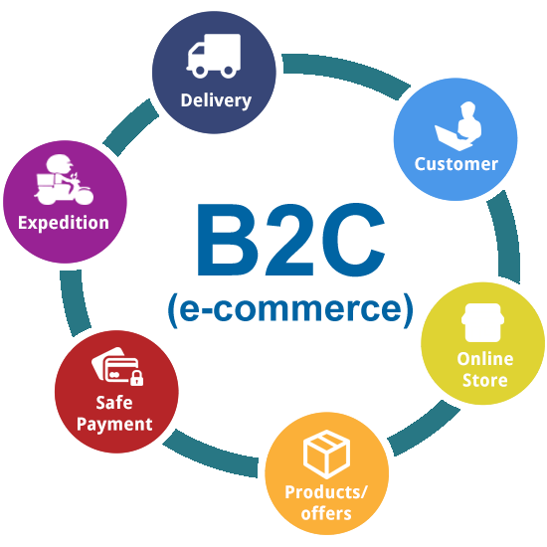
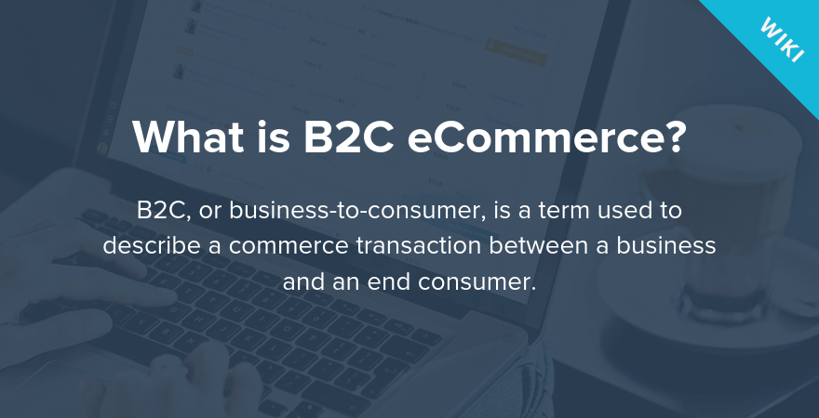
B2C

Slide 10
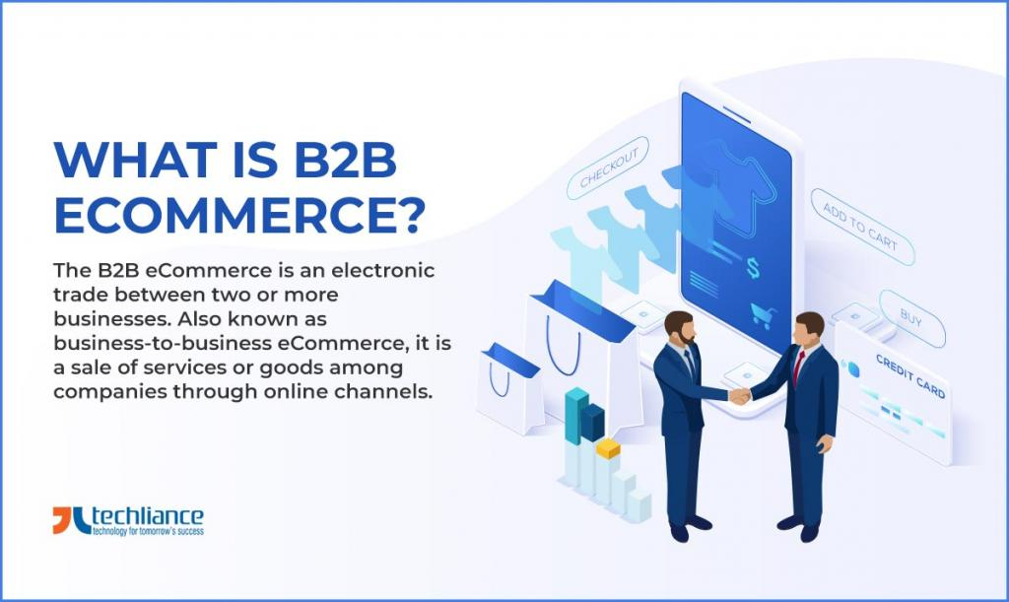
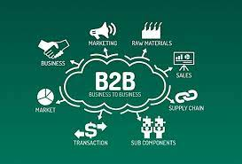
B2B

Slide 11
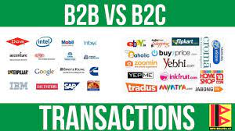

Slide 12
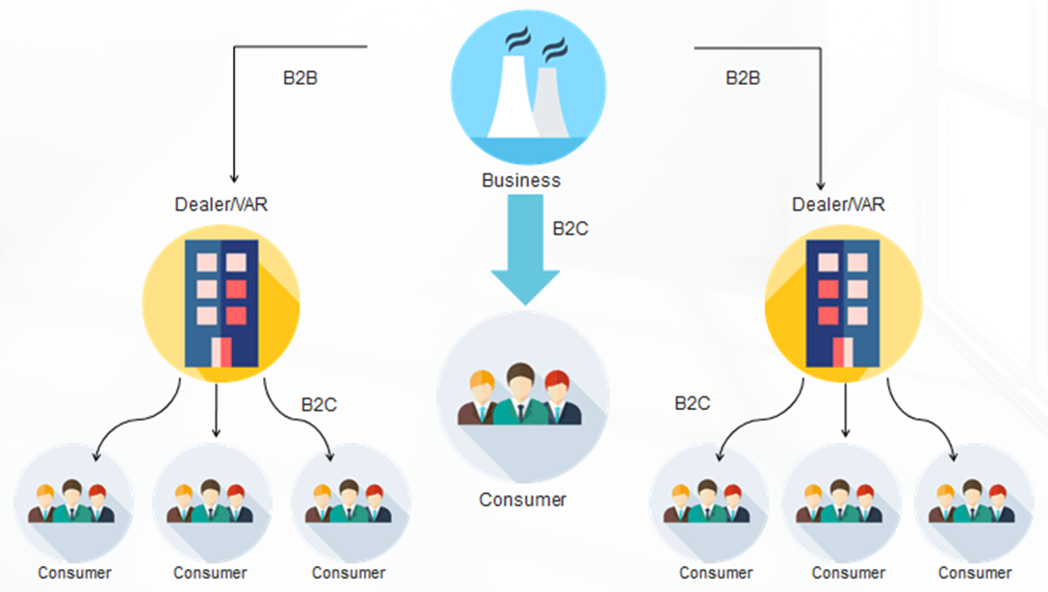

Slide 13
Marketplace
Marketplace may refer to an open space or square in a town where people buy and sell things, i.e., a street market. It also means ‘the market‘ in the abstract sense. For example, for a product to compete effectively in the marketplace, it needs to sell at the right price.

Slide 14
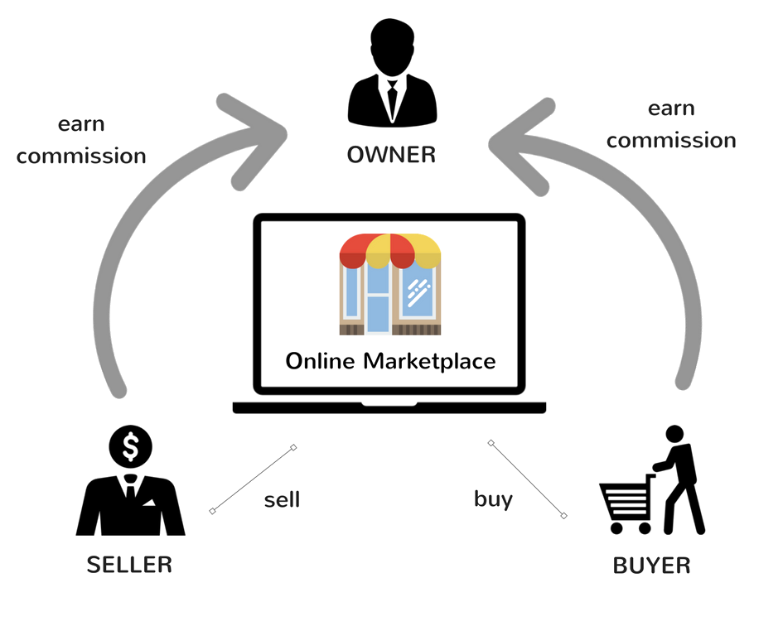

Slide 15
Advantages
You don’t need to have your own website. It represents a saving not having to create a platform, integrates a payment method and maintains it.
You save on advertising. It is the Marketplace that is in charge of promoting itself and the better they do it, the more visibility you will have.
You reach a lot of people. It is true that there will be a lot of competition, but there will also be many users interested in buying your products. Maybe you forget about payment and shipping. There is some Marketplace that takes care of everything and, usually in exchange for a commission, manage cumbersome parts such as the process of payment and shipping.

Slide 16
Customer Experience

Slide 17
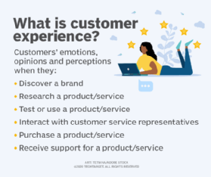

Slide 18
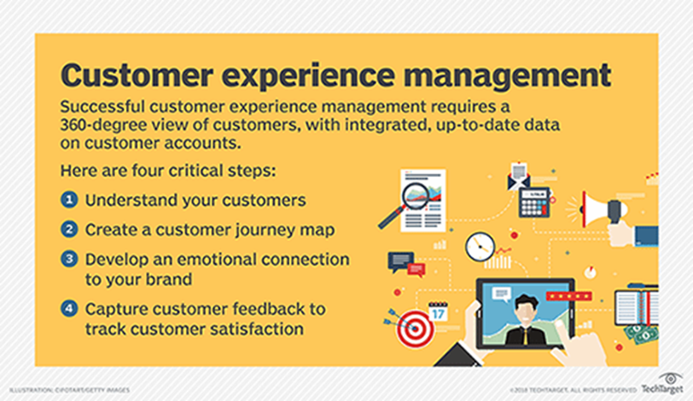

Slide 19
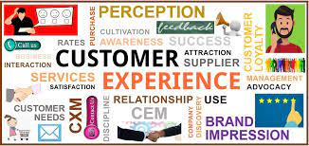

Slide 20
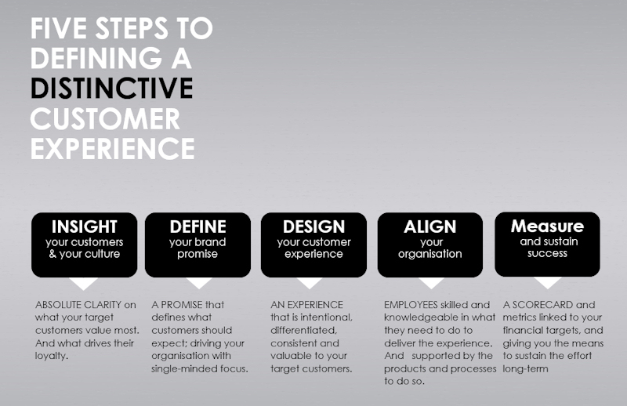

Slide 21
Web Analytics

Slide 22
